Slide 1

Vue JS
Rehana

Slide 2
Agenda
Introduction
History
Vue Js vs Angular
DOM
Component
Template
Class and Style binding
Event handling,
Lifecycle Methods
Watchers
Setup
Demo

Slide 3
Introduction
An Open-source progressive JavaScript framework
Used to develop interactive web user interfaces and single-page applications.
Designed for frontend development, so it has to deal with a lot of HTML, JavaScript and CSS files.
Vue.js facilitates users to extend HTML with HTML attributes called directives.
Vue.js provides built-in directives and a lot of user-defined directives to enhance functionality to HTML applications.

Slide 4
History
Created by Evan
extracted some parts of AngularJS and built something lightweight JavaScript framework later released as Vue.js.
Version | Release date | Title of the version
0.6 | Dec 8, 2013 | N/A
0.7 | Dec 24, 2013 | N/A
0.8 | Jan 27, 2014 | N/A
0.9 | Feb 25, 2014 | Animatrix
0.10 | Mar 23, 2014 | Blade Runner
0.11 | Nov 7, 2014 | Cowboy Bebop
0.12 | Jun 12, 2015 | Dragon Ball
1.0 | Oct 27, 2015 | Evangelion
2.0 | Sep 30,2016 | Ghost in the Shell
2.1 | Nov 22, 2016 | Hunter X Hunter
2.2 | Feb 26, 2017 | Initial D
2.3 | Apr 27, 2017 | JoJo's Bizarre Adventure
2.4 | Jul 13, 2017 | Kill la Kill
2.5 | Oct 13, 2017 | Level E
2.6 | Feb 4, 2019 | Sword Art Onlin: Alicization

Slide 5
Vue.js Vs Angular
Angular is a web application framework, and Vue is a Progressive framework
Angular JS is opinionated, which means there is a certain way application should be structured, whereas Vue JS is modular and flexible.
Vue uses JavaScript, whereas Angular uses TypeScript
Vue is easy to learn comparable to Angular
Angular is useful for a large application, whereas Vue is indicated for a small team

Slide 6
Virtual DOM
Vue.js uses virtual DOM like other existing frameworks such as ReactJS, Ember, etc.
The virtual DOM (VDOM) is a programming concept where an ideal, or “virtual”, representation of a UI is kept in memory and synced with the “real” DOM.
The concept was pioneered by React and has been adapted in many other frameworks with different implementations, including Vue.
Virtual DOM is a lightweight in-memory tree representation of the original HTML DOM and is updated without affecting the initial DOM.

Slide 7
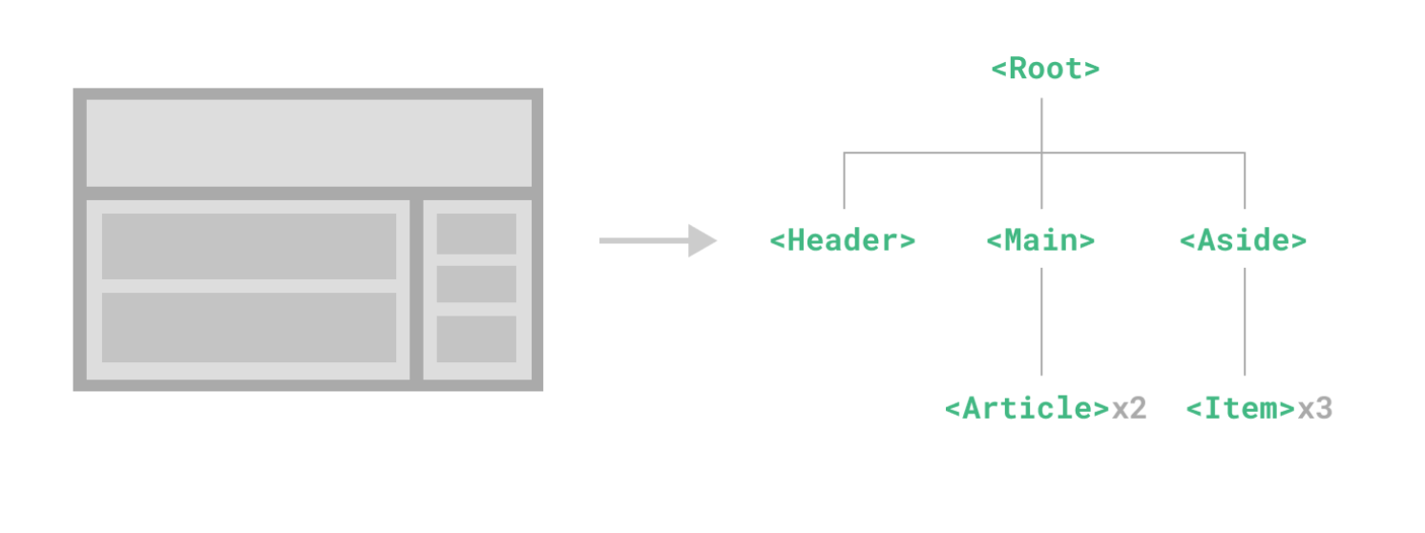
Component
create custom elements that can be reused in HTML.
Components are the reusable Vue.js instances with a name
Syntax:
Vue.component('nameofthecomponent',{ // options});

Slide 8
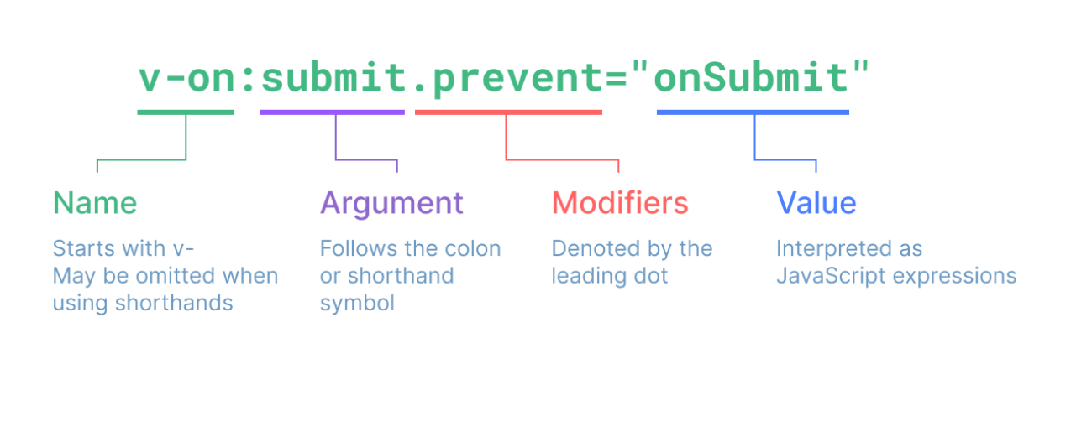
Template
Vue uses an HTML-based template syntax.
Allows to declaratively bind the rendered DOM to the underlying component instance's data.

Slide 9
Data Binding
Data binding is a technique used to bind data sources from the provider and consumer together and synchronize them at the time of retrieval.
Vue.js supports different types of data binding.
Class list and inline style are attributes, we can use v-bind to handle them.
Vue.js provides special enhancements when we use v-bind with class and style.

Slide 10


Event Handling
Events are used to respond to an action
If we want to handle a click-on-a-button element then we should add the following code to our Vue template:

Slide 11
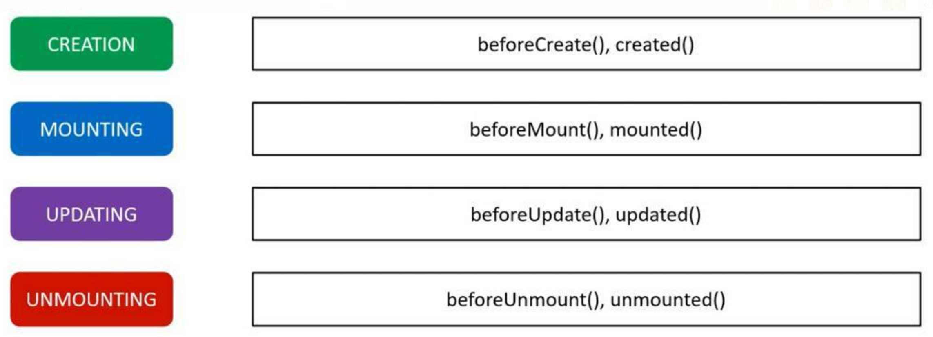
Component Lifecycle Hooks
A Vue component can go through four phases.
Creation
Mounting
Updating
Unmounting

Slide 12
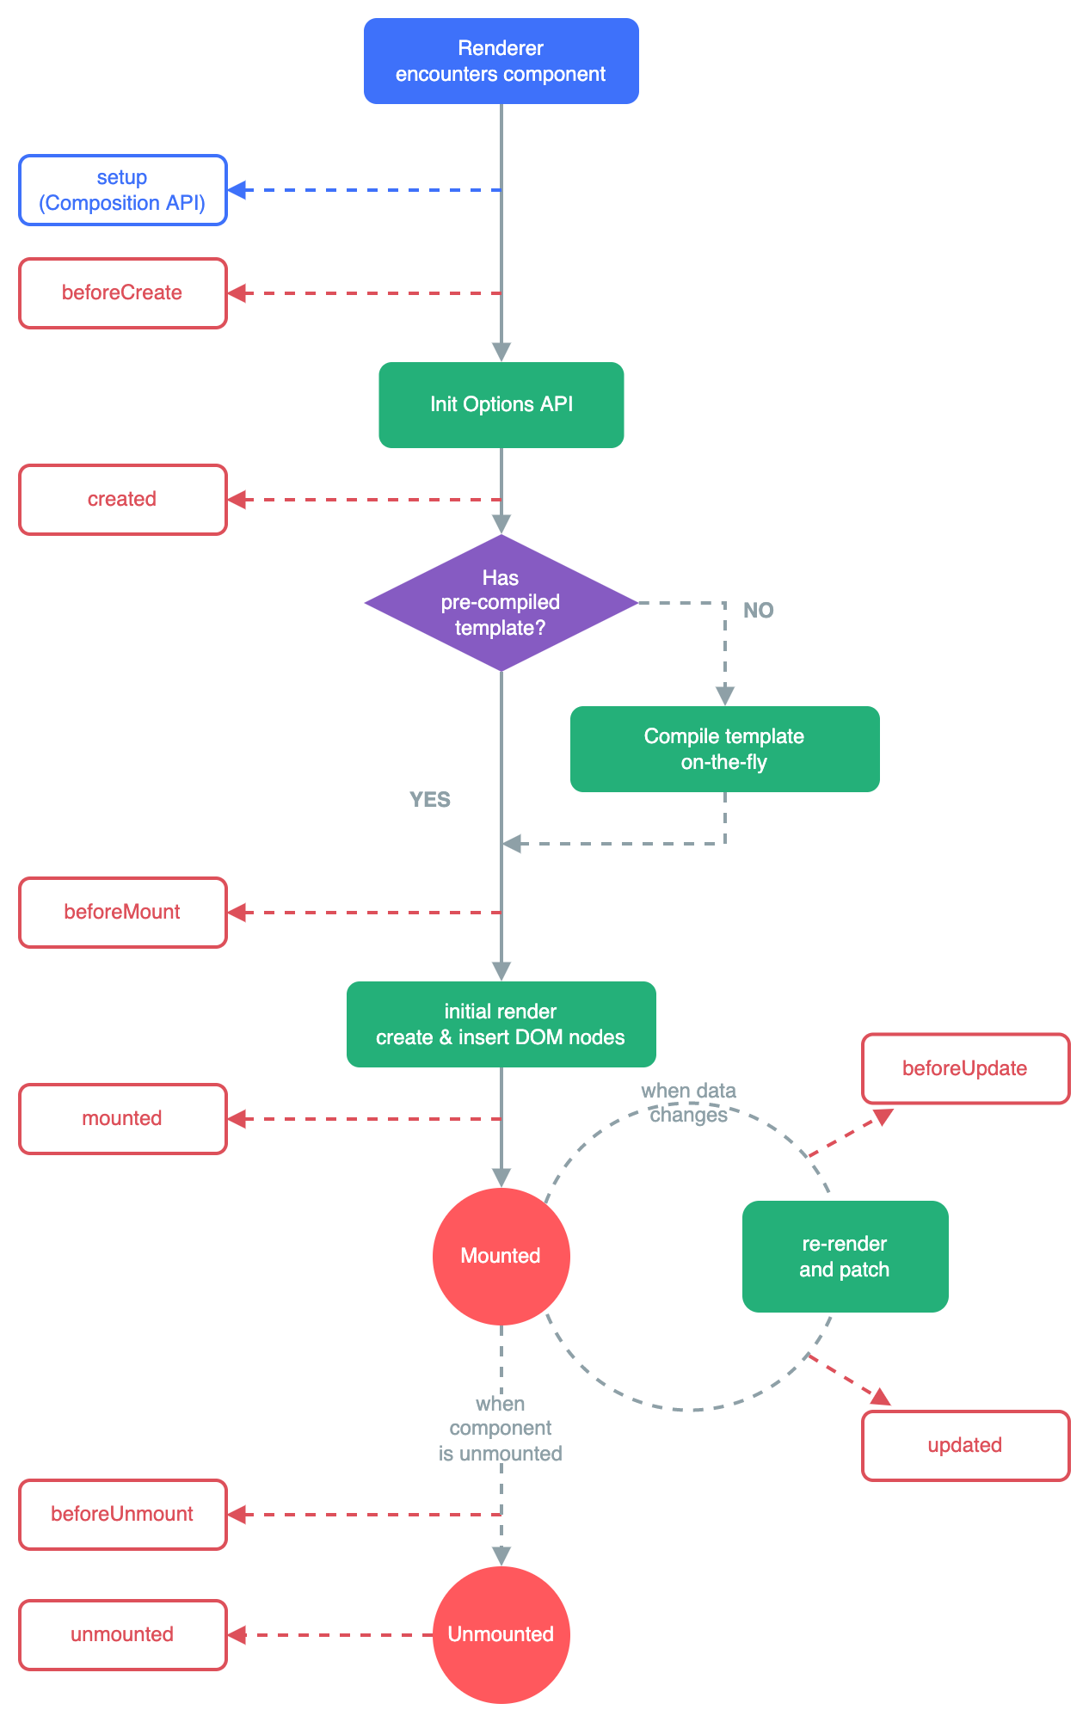

Slide 13
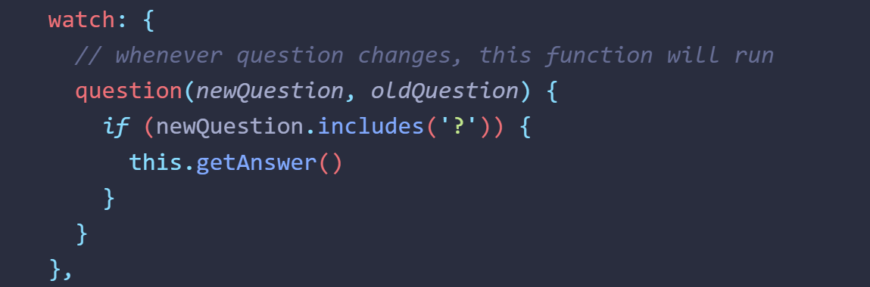
Watchers
Allows to watch any data or computed property and execute some code in response to changes in the value.

Slide 14
Set up
Prerequisites:
Knowledge of the command line
Install Node.js version 16.0 or higher

Slide 15
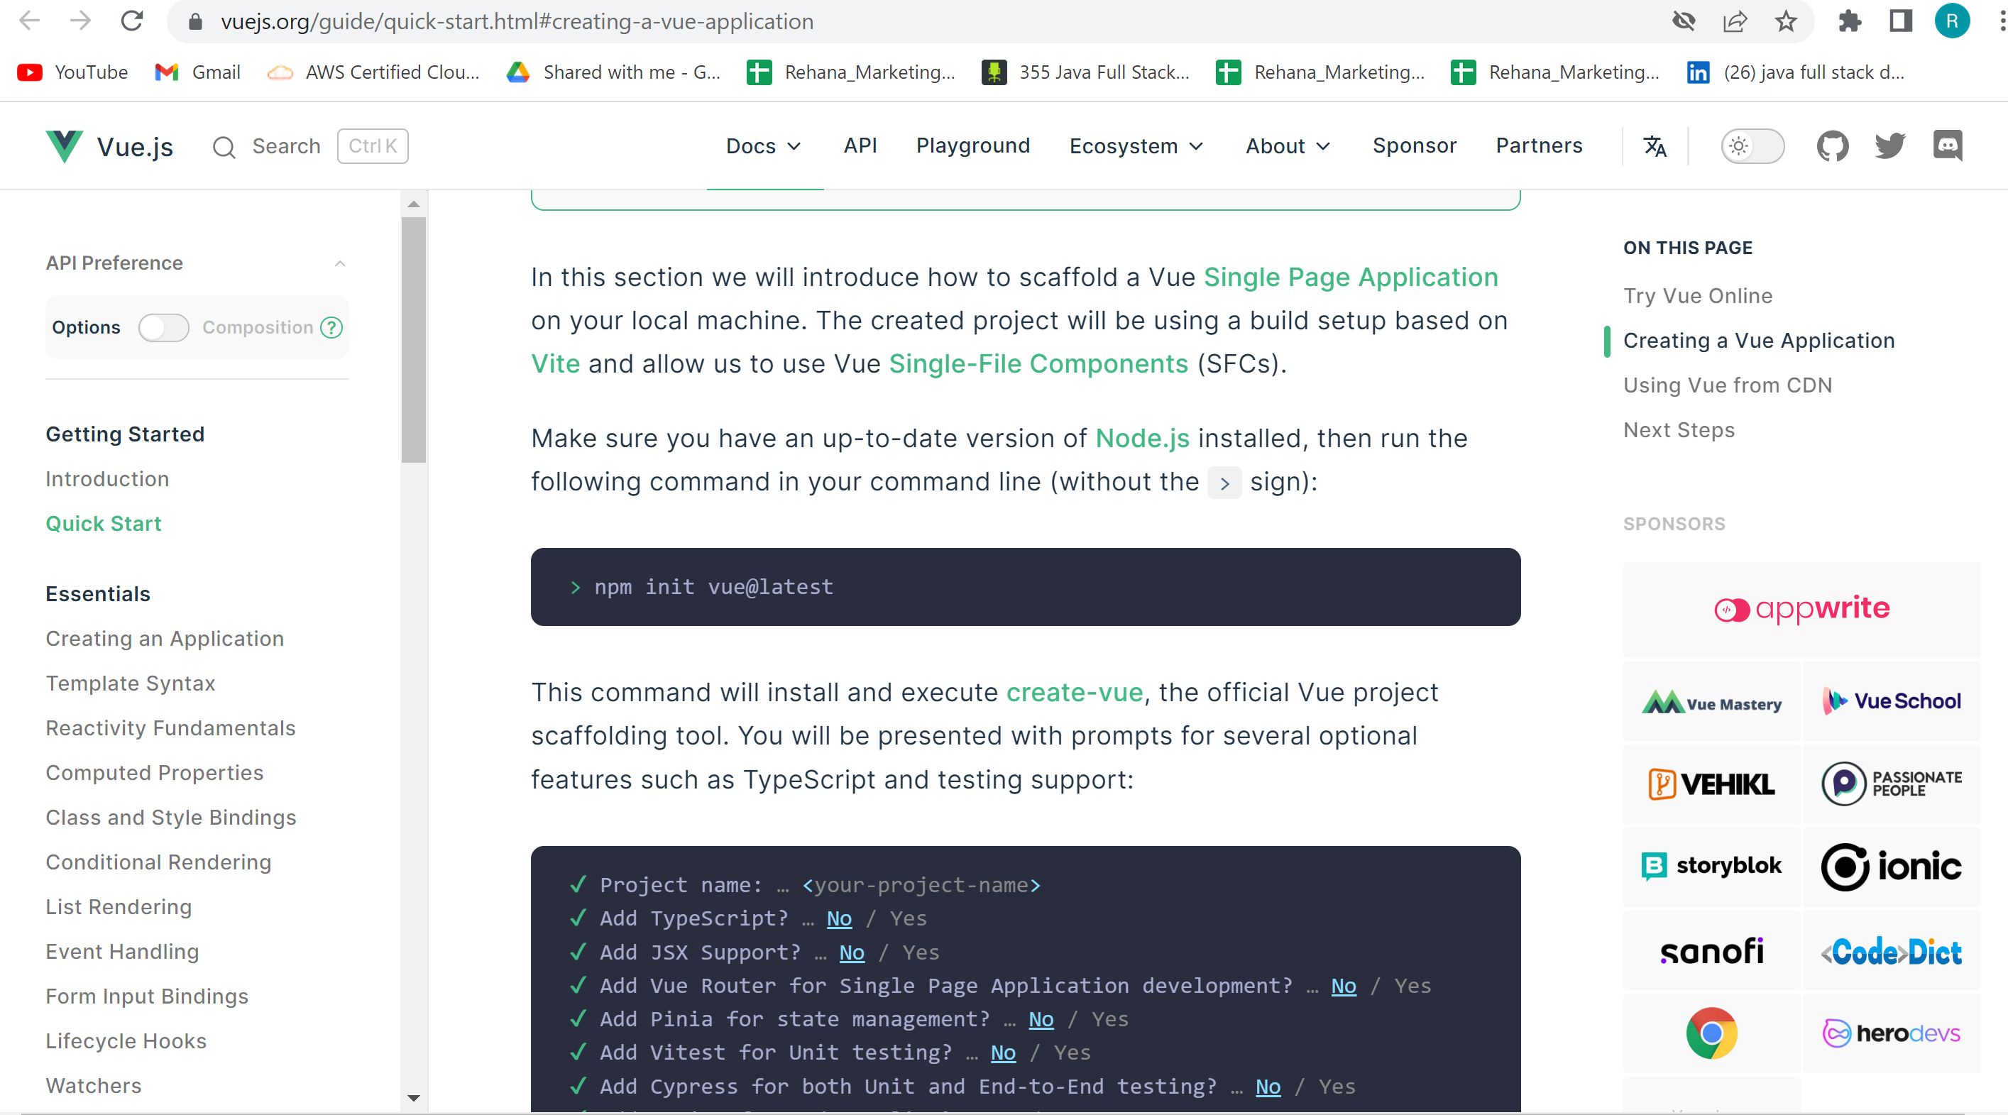

Slide 16
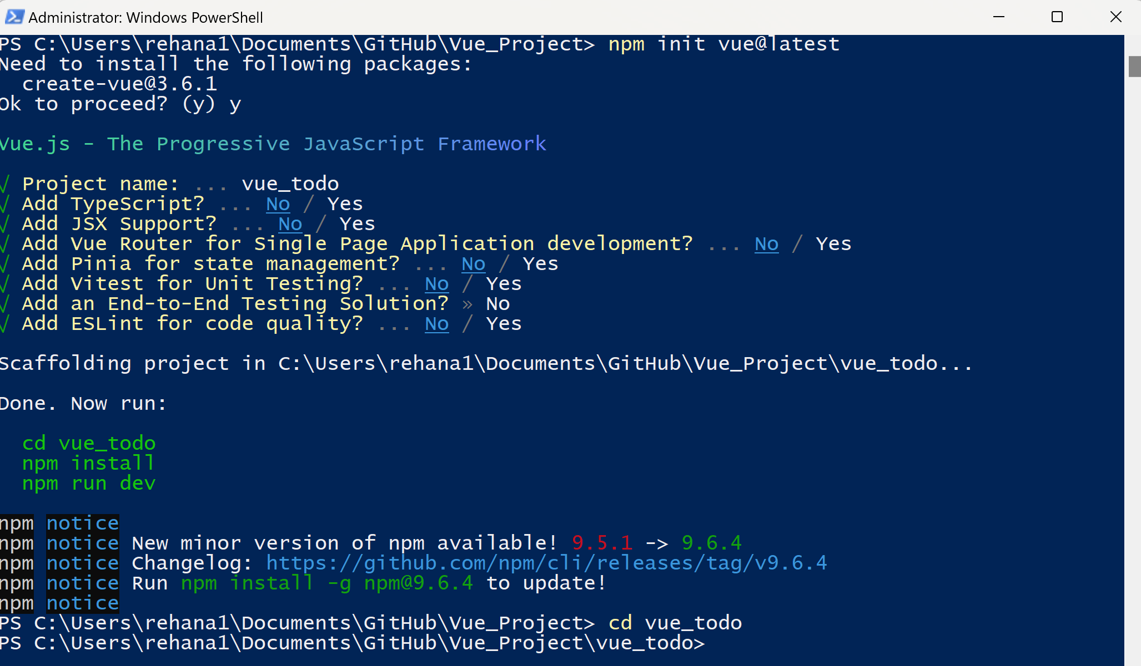

Slide 17
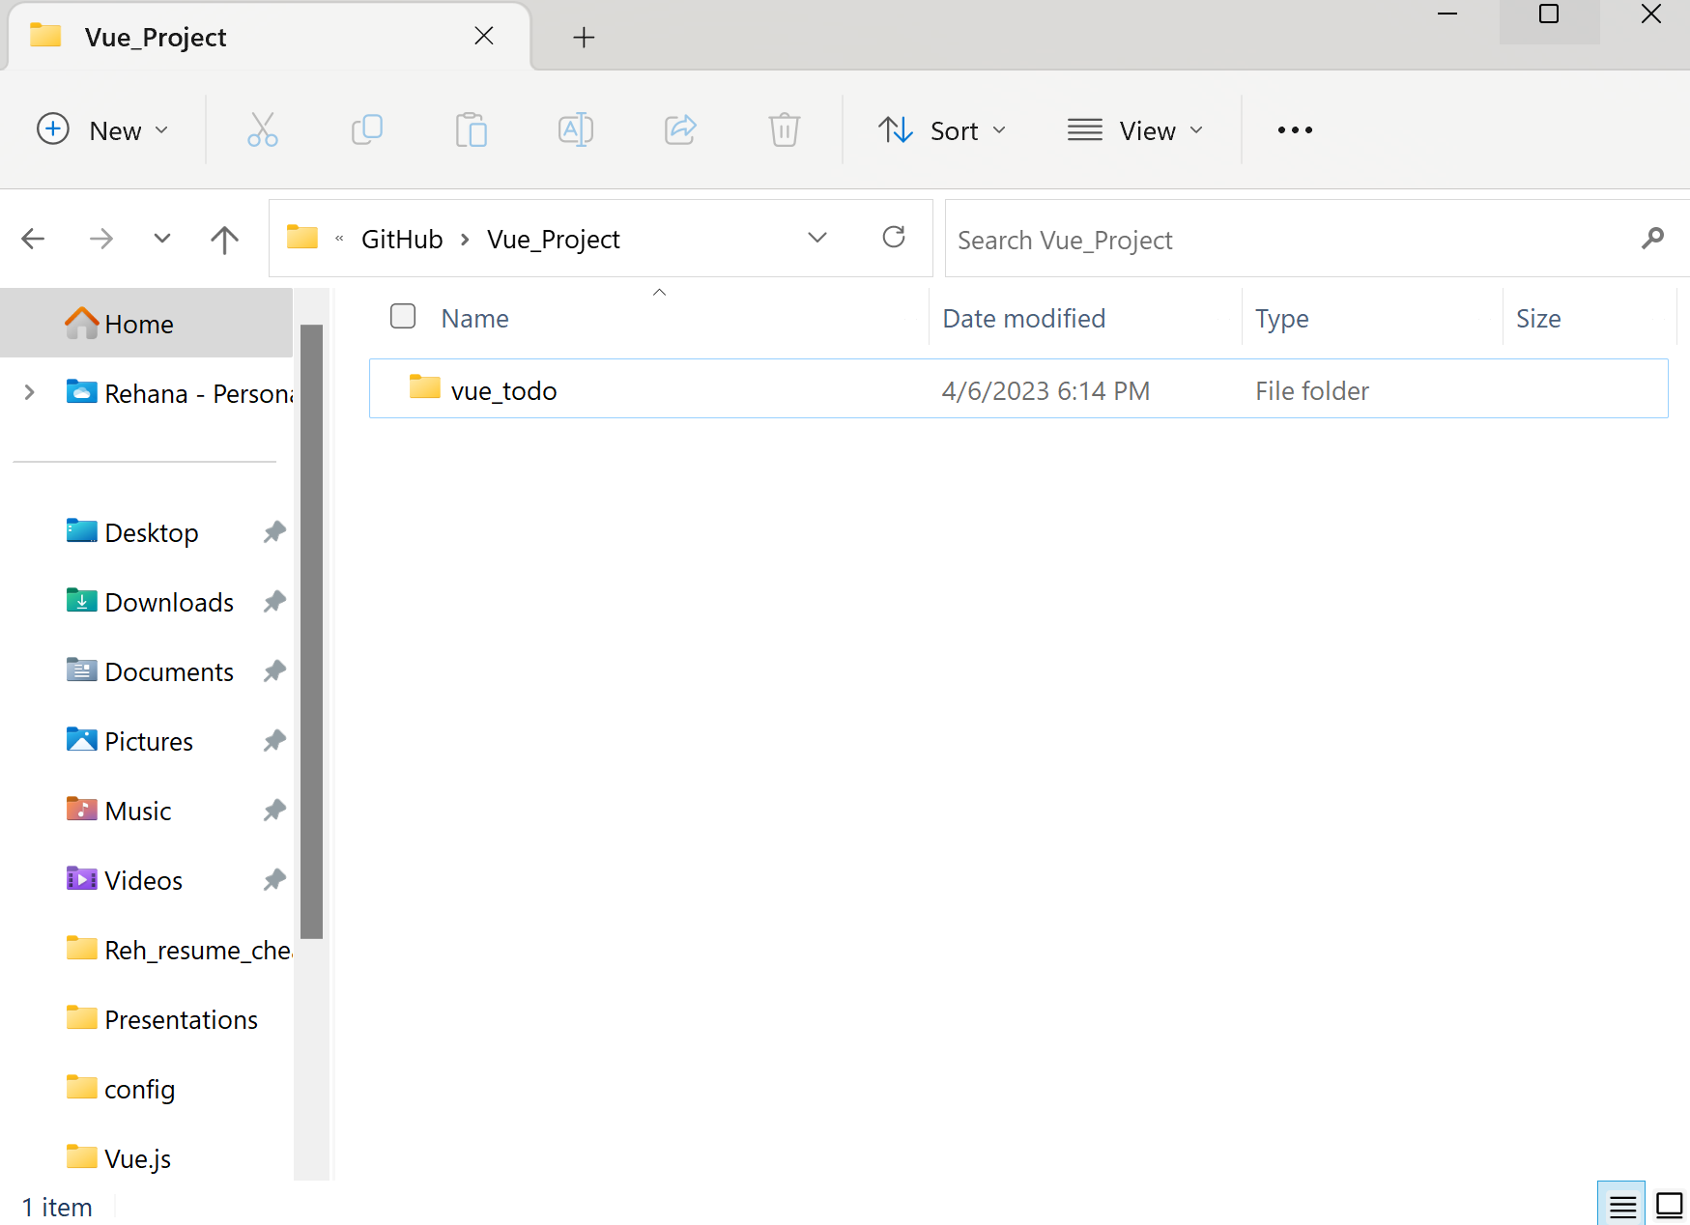

Slide 18
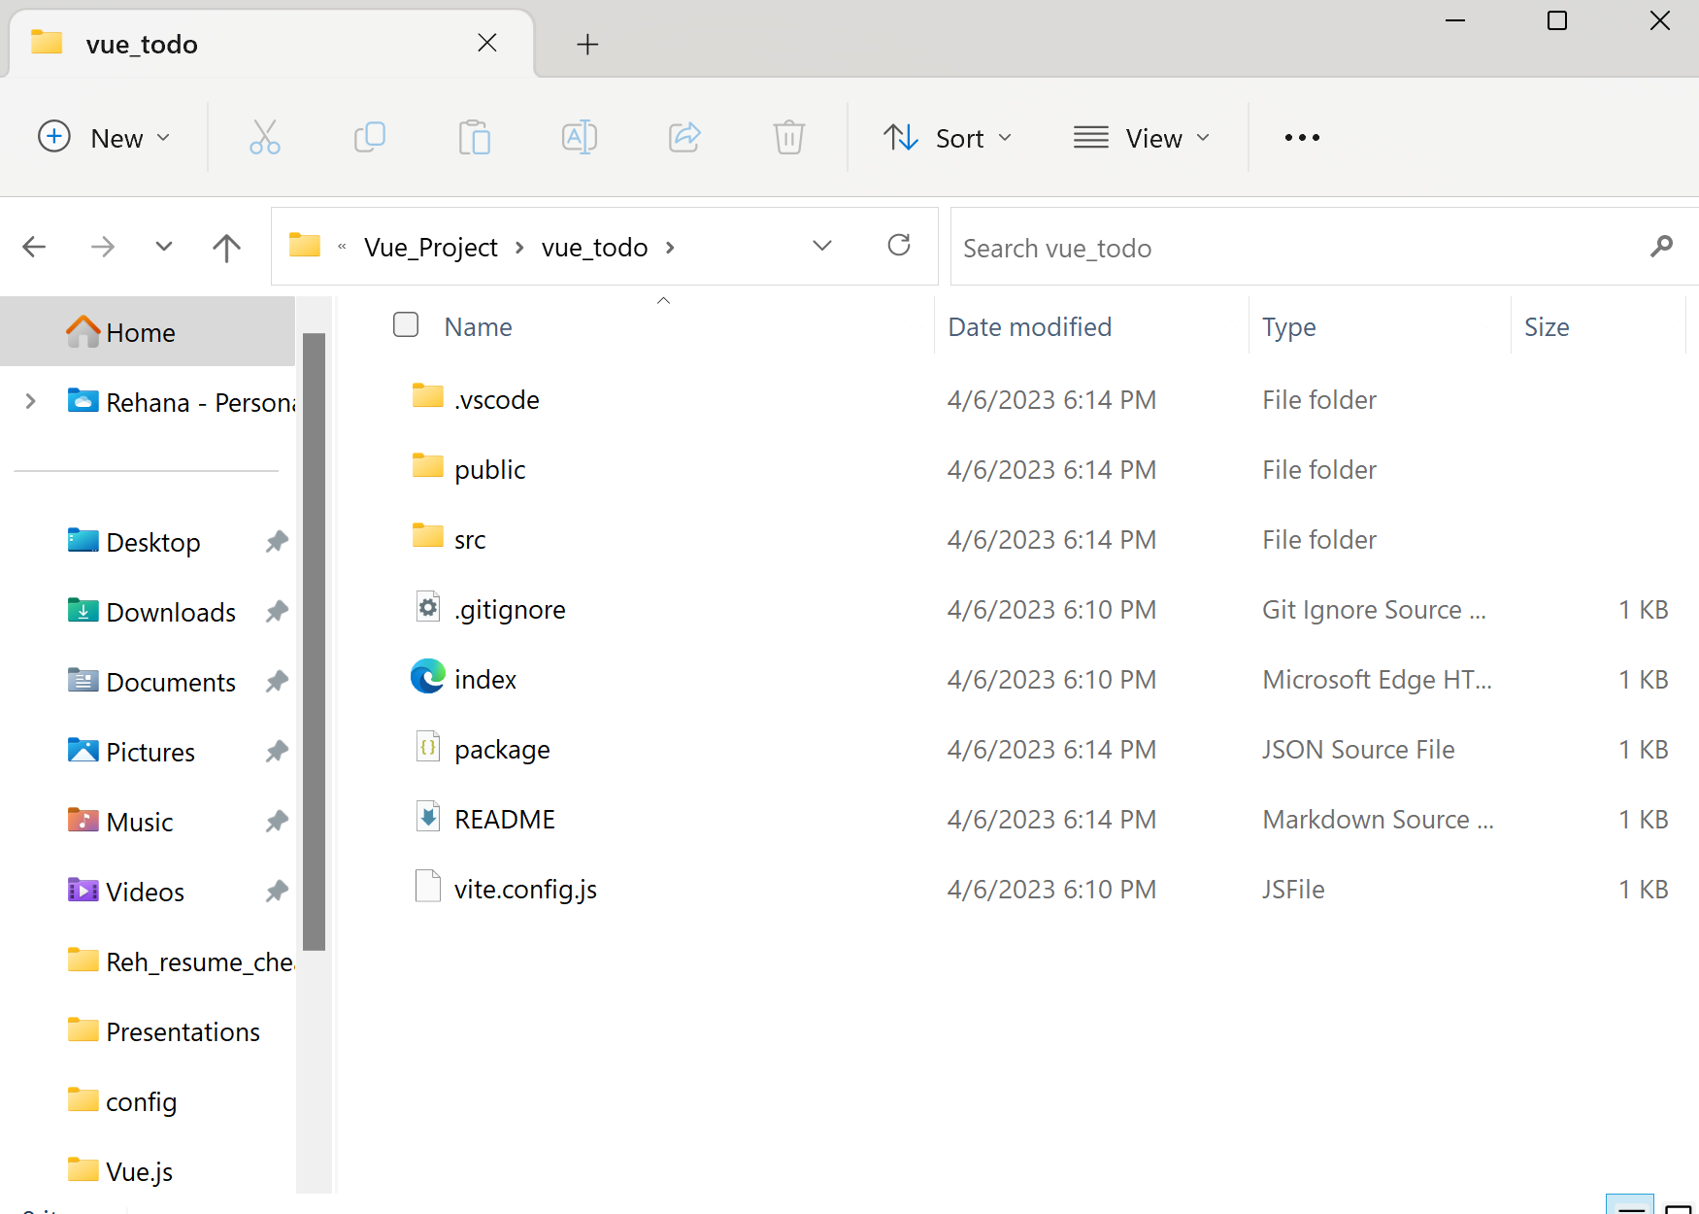

Slide 19
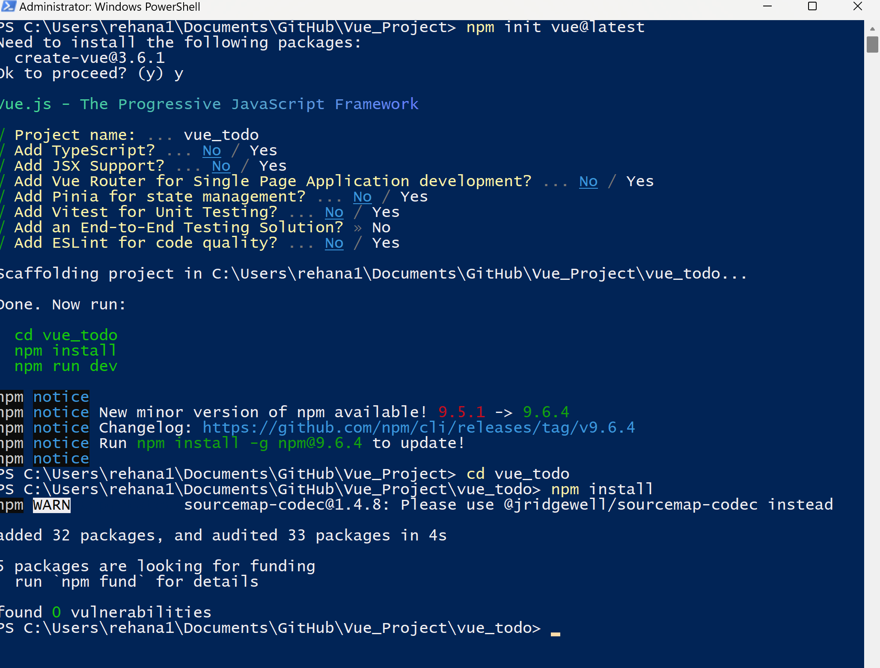

Slide 20
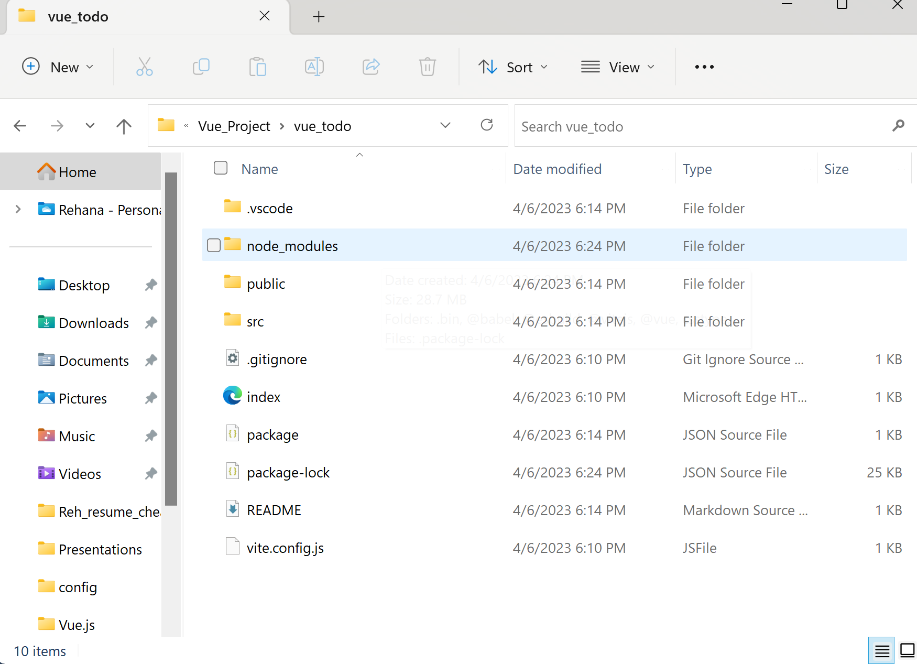

Slide 21
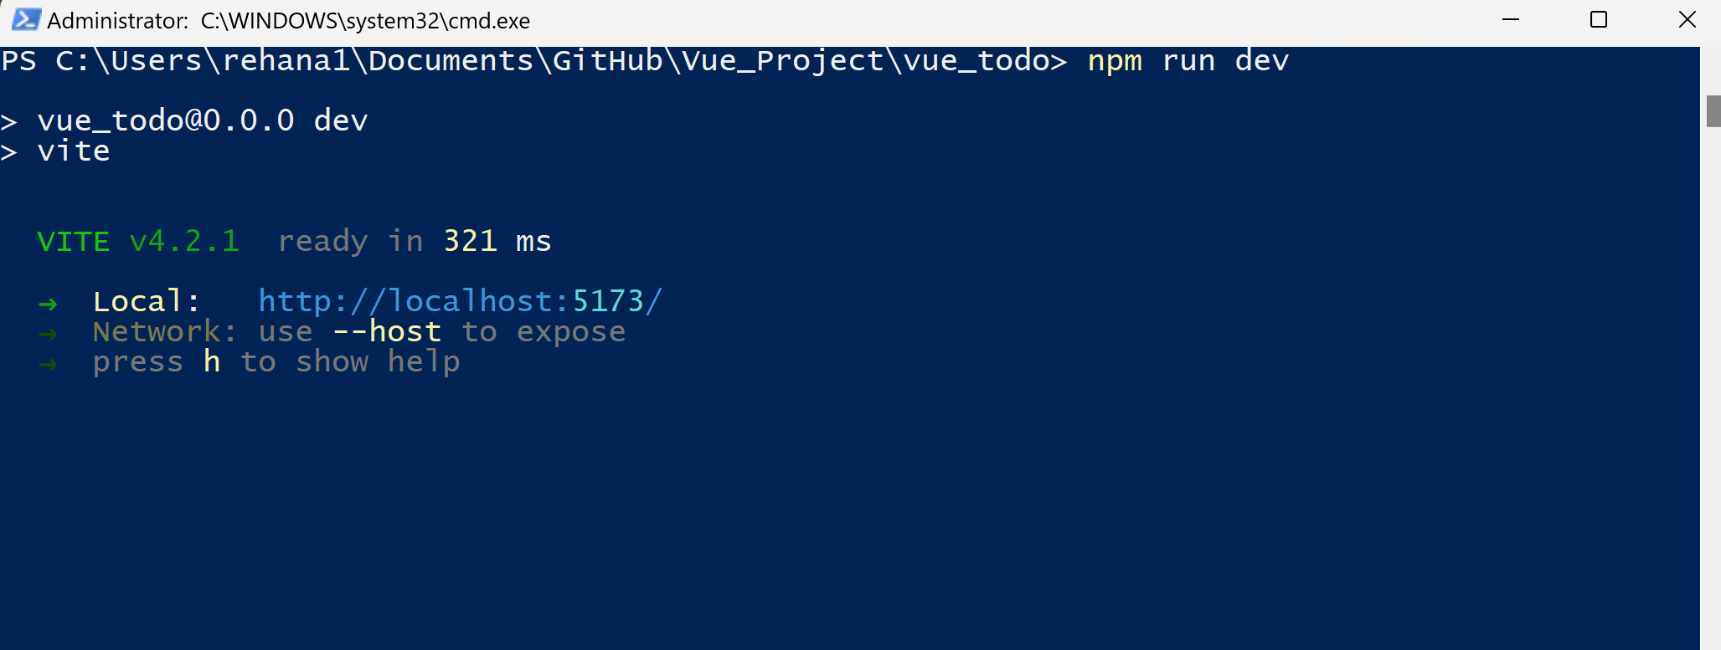

Slide 22
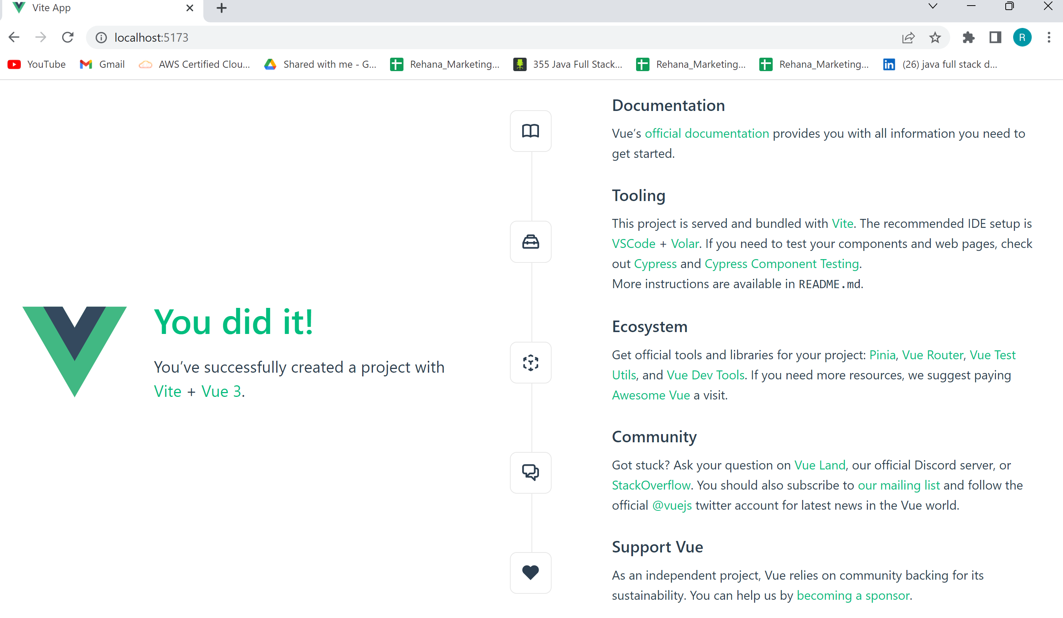

Slide 23
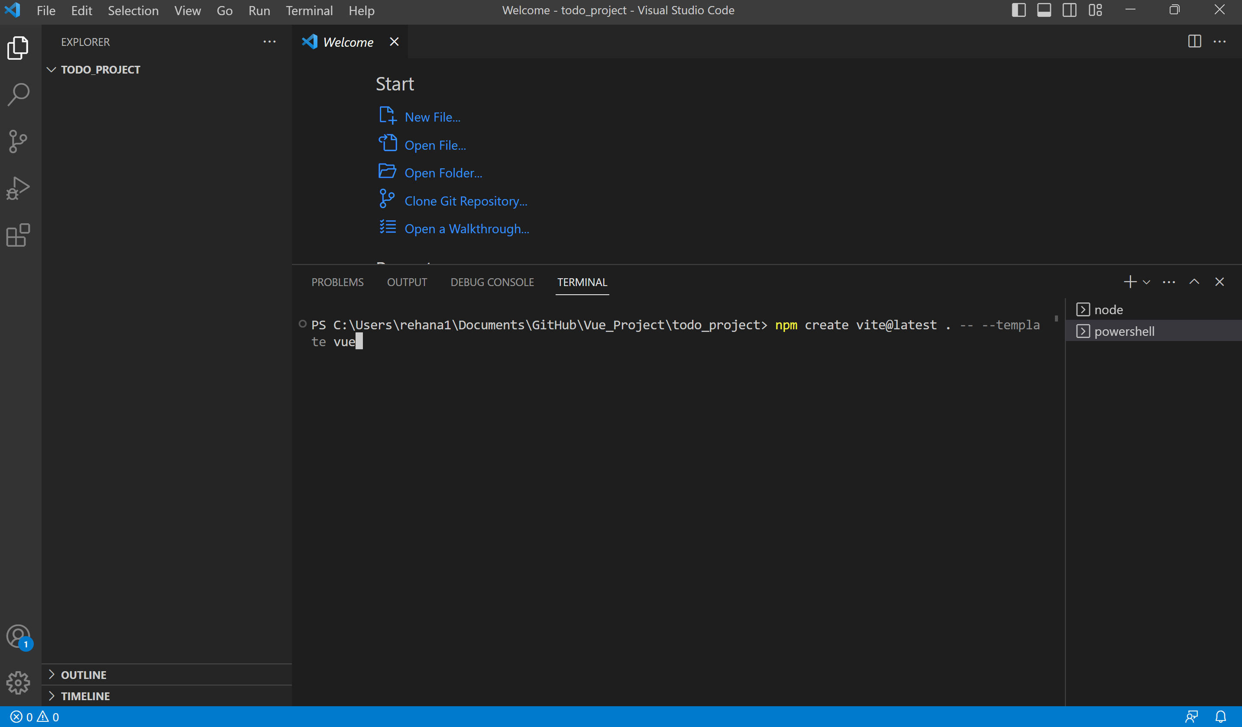

Slide 24
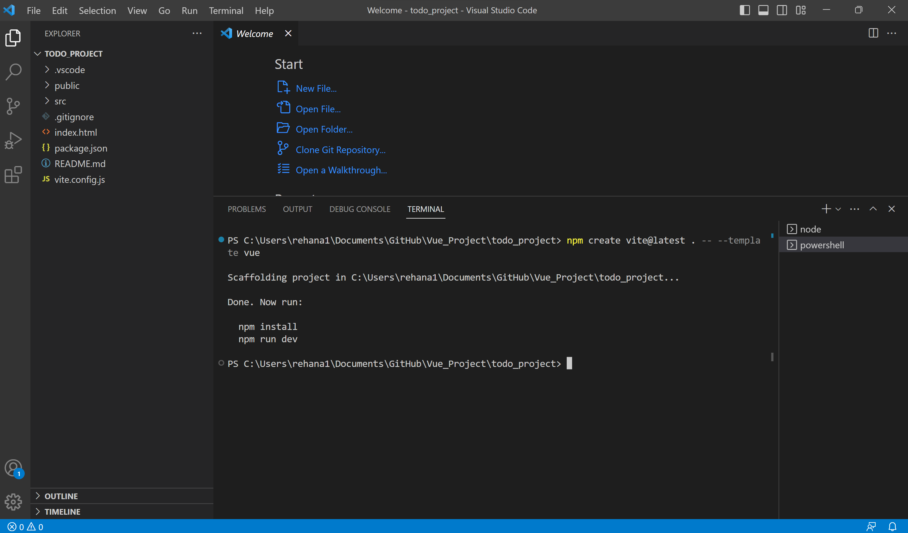

Slide 25
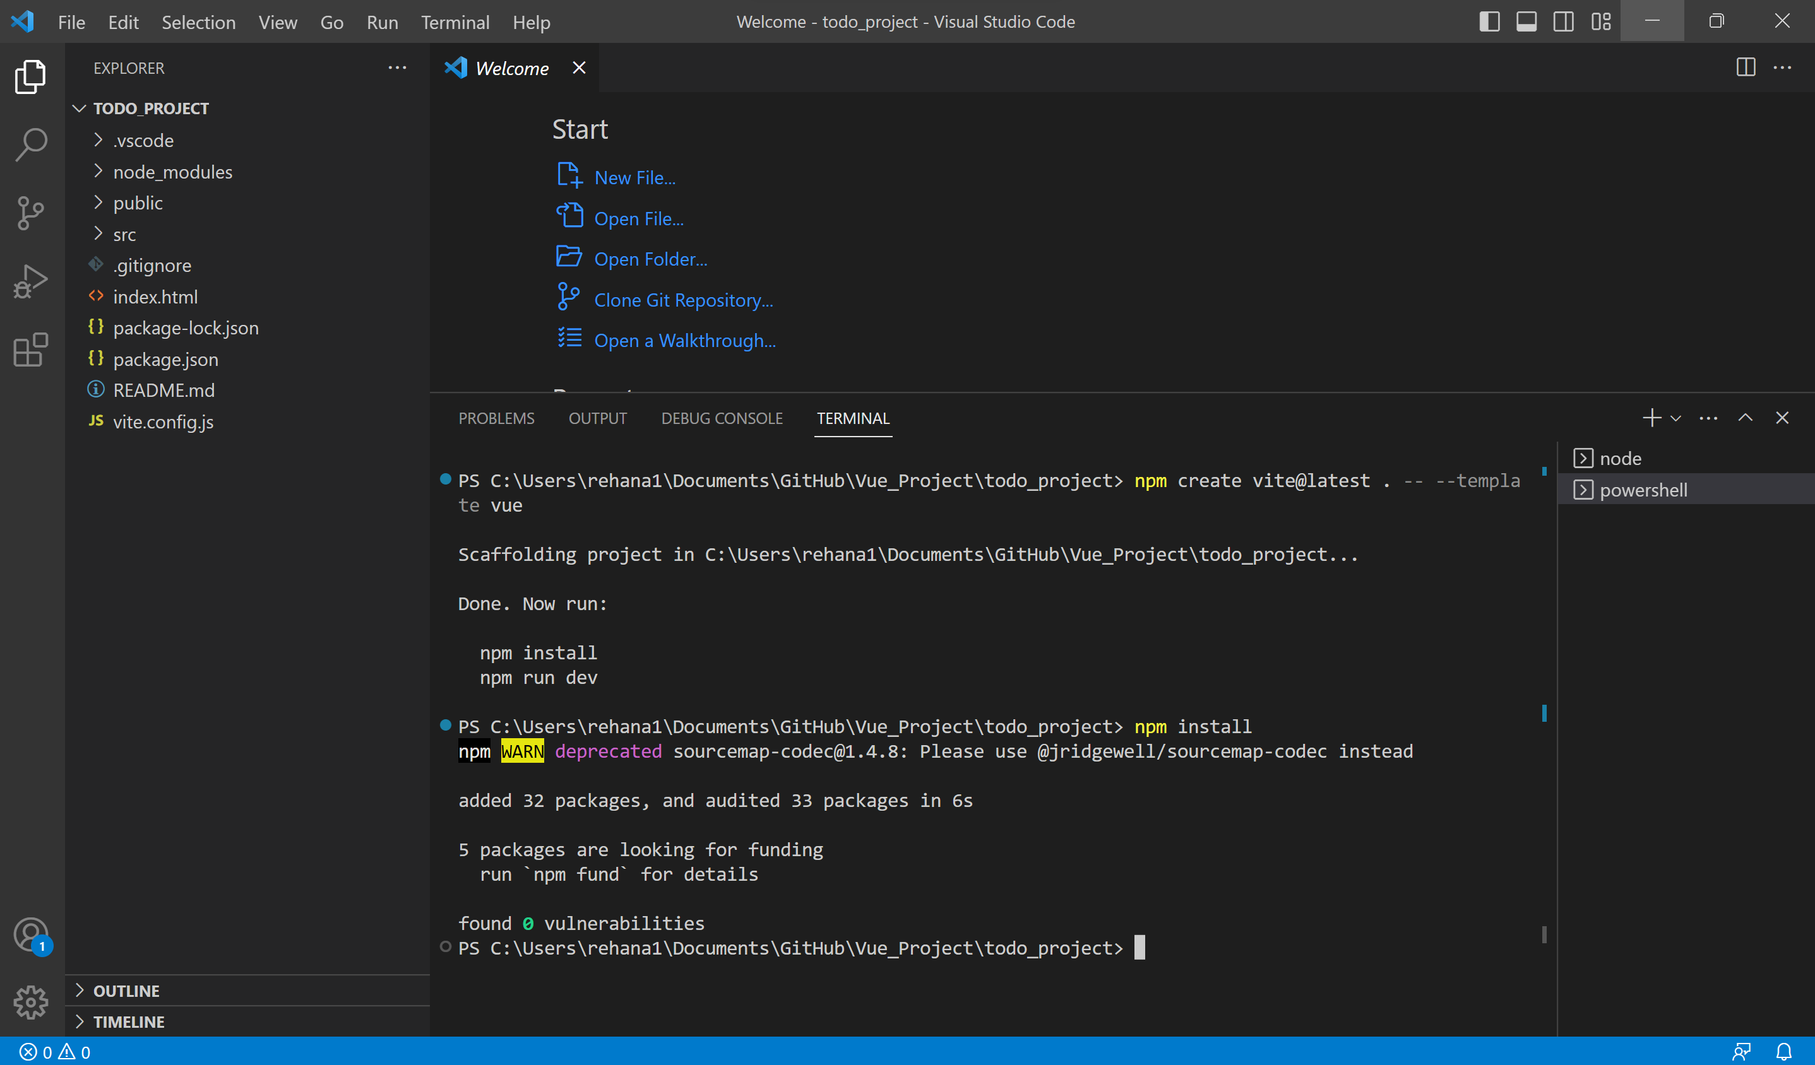

Slide 26
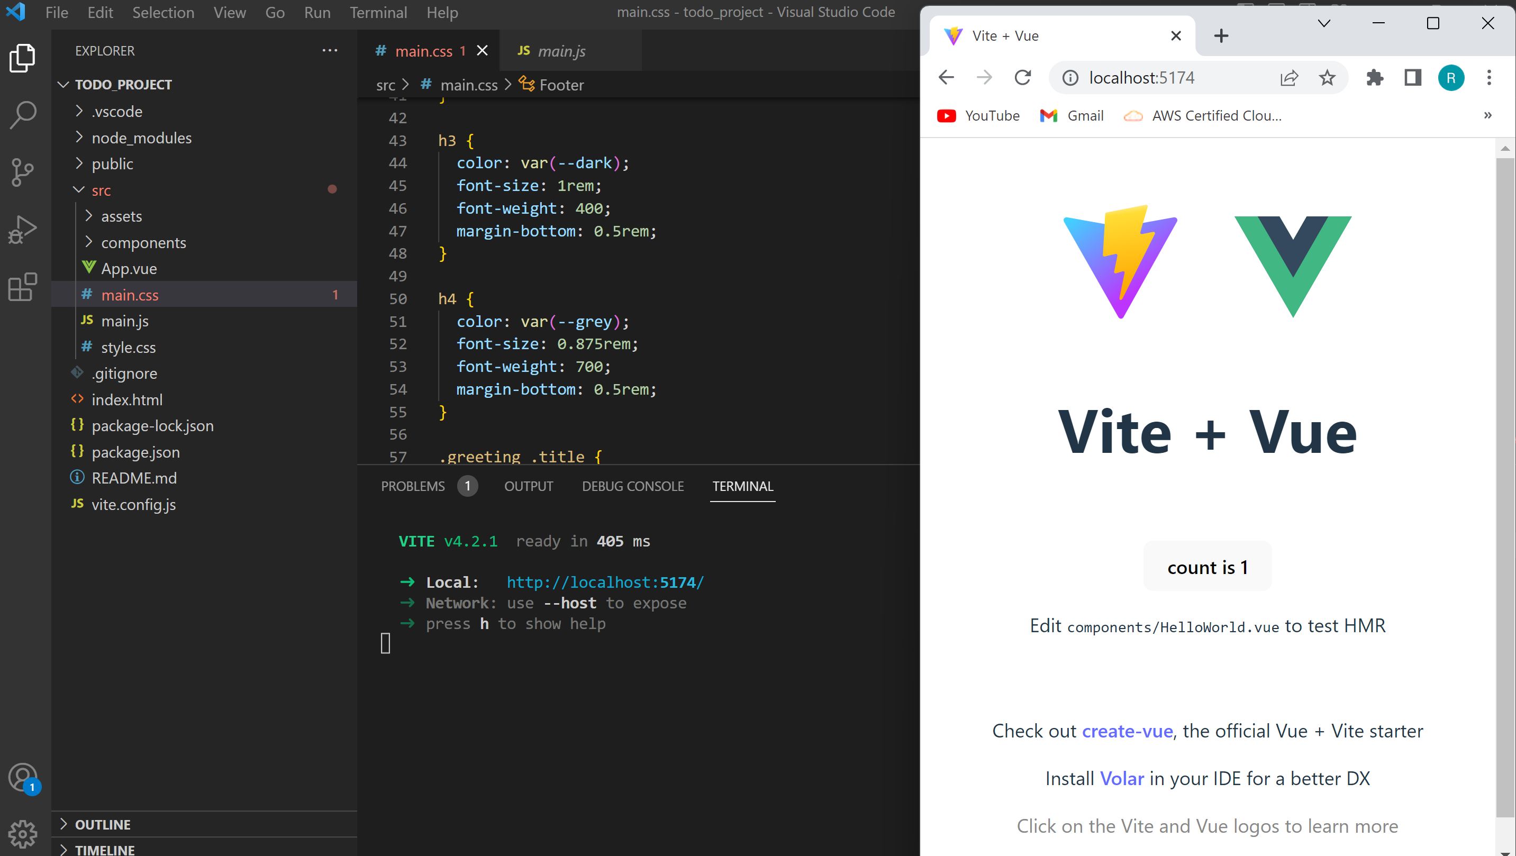

Slide 27
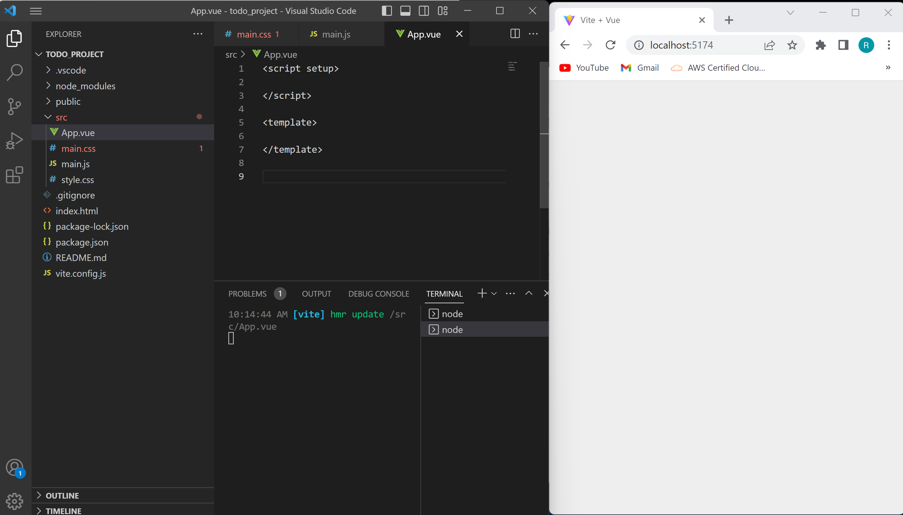

Slide 28
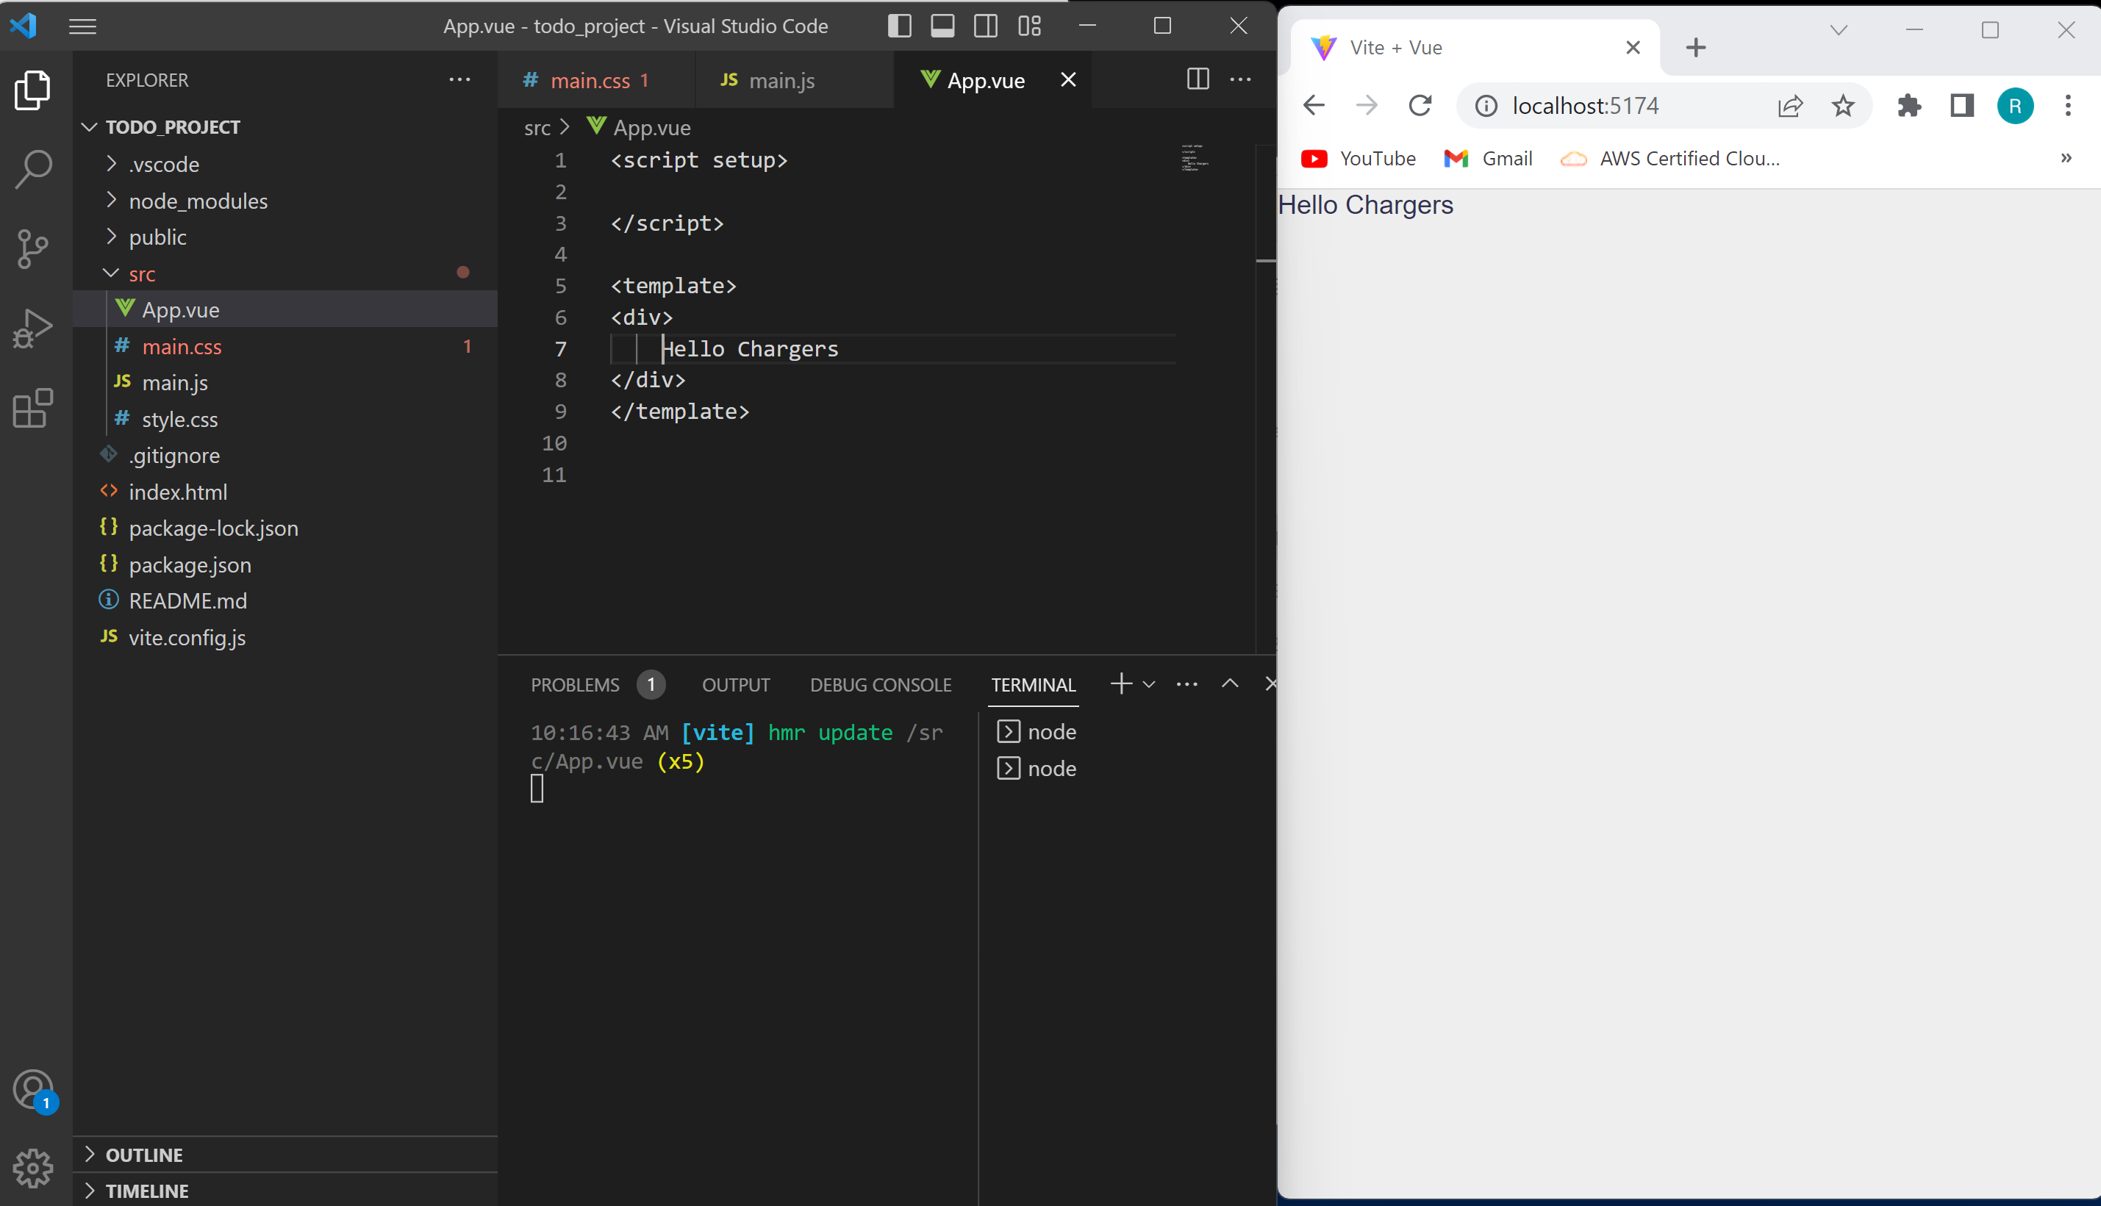

Slide 29
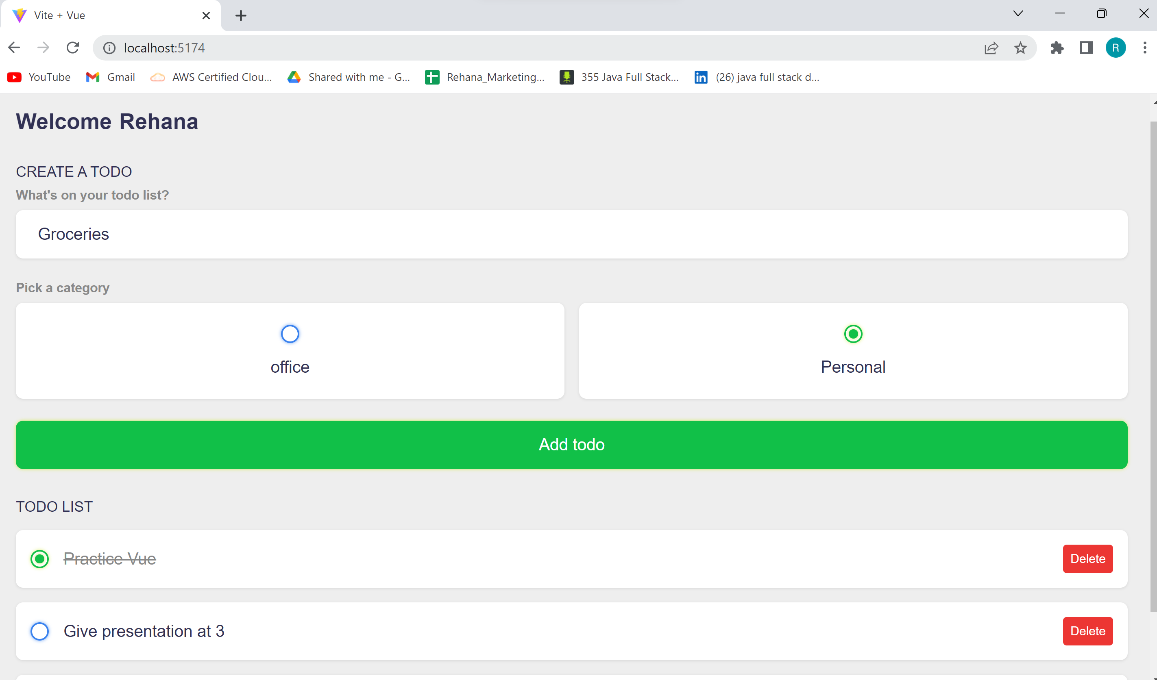

Slide 30
Thank you

